Slide 1

Module 2
matrix arithmetic
operations on matrices
eigenvalues & eigenvectors

Slide 2
Module 2
Matrix arithmetic

Slide 3
Matrix operations
Addition and subtraction
Scalar multiplication
Multiplication
Inverse

Slide 4

addition and scalar multiplication
The sum of two $m×n$ matrices $A$ and $B$ is the $m×n$ matrix $A+B$ in which each element is the sum of the corresponding elements of $A$ and $B$.
The product of a scalar $k$ and a matrix $A$ is the matrix $kA$, in which each element is $k$ times the corresponding element of $A$.

Slide 5
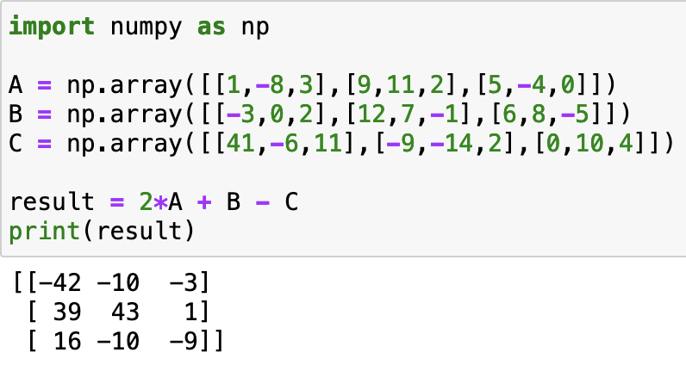

example 1
Suppose $A=\left[\begin{matrix}1 & −8 & 3 \\ 9 & 11 & 2 \\ 5 & −4 & 0\end{matrix}\right], B=\left[\begin{matrix}−3 & 0 & 2 \\ 12 & 7 & −1 \\ 6 & 8 & −5\end{matrix}\right], C=\left[\begin{matrix}41 & −6 & 11 \\ −9 & −14 & 2 \\ 0 & 10 & 4\end{matrix}\right]$. Find $2A+B−C$
$$2A+B−C=(2)\left[\begin{matrix}1 & −8 & 3 \\ 9 & 11 & 2 \\ 5 & −4 & 0\end{matrix}\right]+\left[\begin{matrix}−3 & 0 & 2 \\ 12 & 7 & −1 \\ 6 & 8 & −5\end{matrix}\right]−\left[\begin{matrix}41 & −6 & 11 \\ −9 & −14 & 2 \\ 0 & 10 & 4\end{matrix}\right]$$
$$=\left[\begin{matrix}2(1)+\left(−3\right)−41 & 2(−8)+0−(−6) & (2)3+2−11 \\ 2(9)+12−(−9) & 2(11)+7−(−14) & 2(2)+\left(−1\right)−2 \\ 2(5)+6−0 & 2(−4)+8−10 & 2(0)+\left(−5\right)−4\end{matrix}\right]$$
$$=\left[\begin{matrix}−42 & −10 & −3 \\ 39 & 43 & 1 \\ 16 & −10 & −9\end{matrix}\right]$$

Slide 6

Matrix Multiplication
The product $AB$ of two matrices $A$ and $B$ can be found only if the number of columns of $A$ equals the number of rows of $B$.
If $A$ is an $m×n$ matrix and $B$ is an $n×k$ matrix, the product $AB$ will be an $m×k$ matrix
If $A$ is an $m×n$ matrix and $B$ is an $n×m$ matrix, the products $AB$ and $BA$ can both be found. However, $AB≠BA$ in general.

Slide 7
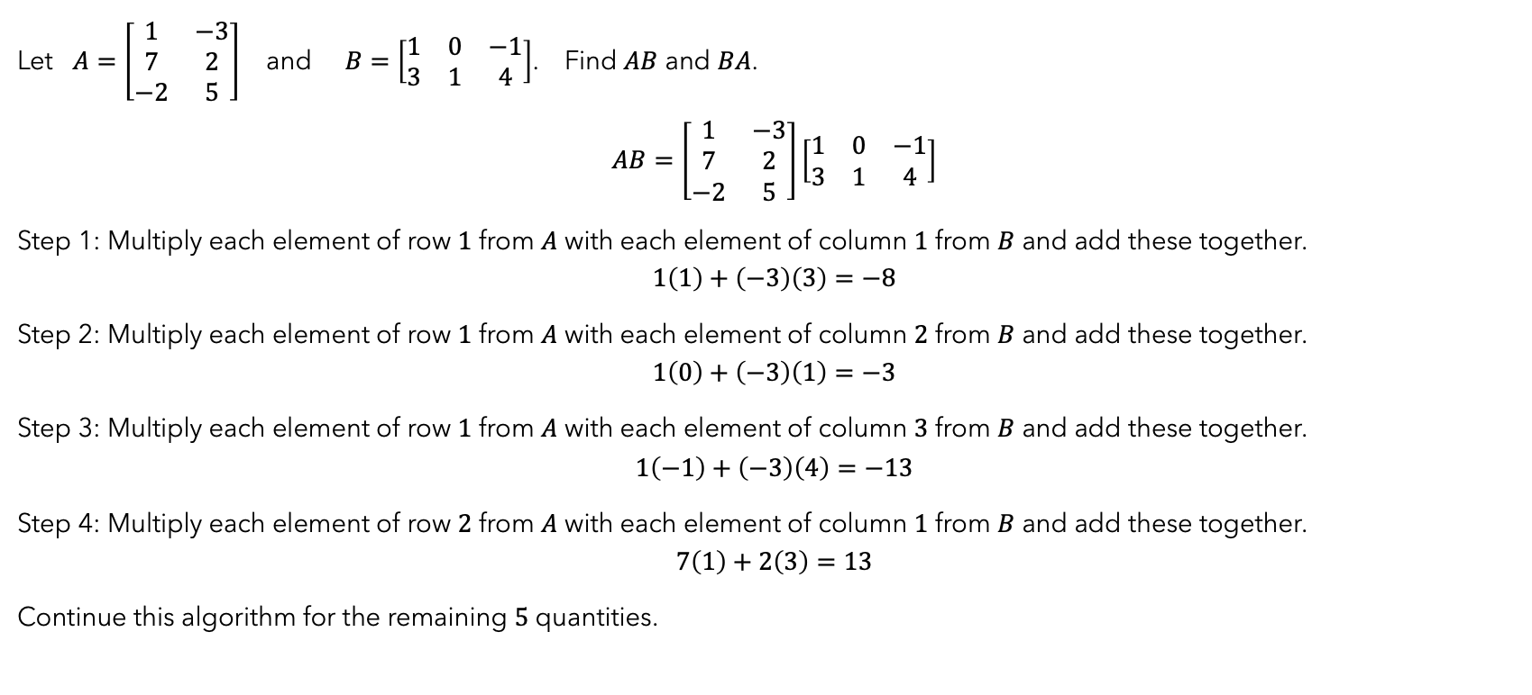
example 2
Let $A=\left[\begin{matrix}1 & −3 \\ 7 & 2 \\ −2 & 5\end{matrix}\right]$ and $B=\left[\begin{matrix}1 & 0 & −1 \\ 3 & 1 & 4\end{matrix}\right]$. Find $AB$ and $BA$.
$$AB=\left[\begin{matrix}1 & −3 \\ 7 & 2 \\ −2 & 5\end{matrix}\right]\left[\begin{matrix}1 & 0 & −1 \\ 3 & 1 & 4\end{matrix}\right]$$
Step 1: Multiply each element of row $1$ from $A$ with each element of column $1$ from $B$ and add these together.
$$1\left(1\right)+\left(−3\right)\left(3\right)=−8$$
Step 2: Multiply each element of row $1$ from $A$ with each element of column $2$ from $B$ and add these together.
$$1\left(0\right)+\left(−3\right)\left(1\right)=−3$$
Step 3: Multiply each element of row $1$ from $A$ with each element of column $3$ from $B$ and add these together.
$$1\left(−1\right)+\left(−3\right)\left(4\right)=−13$$
Step 4: Multiply each element of row $2$ from $A$ with each element of column $1$ from $B$ and add these together.
$$7\left(1\right)+2\left(3\right)=13$$
Continue this algorithm for the remaining $5$ quantities.

Slide 8

example 2 continued
$$AB=\left[\begin{matrix}1 & −3 \\ 7 & 2 \\ −2 & 5\end{matrix}\right]\left[\begin{matrix}1 & 0 & −1 \\ 3 & 1 & 4\end{matrix}\right]$$
$$=\left[\begin{matrix}1\left(1\right)+(−3)(3) & 1\left(0\right)+(−3)(1) & 1\left(−1\right)+(−3)(4) \\ 7\left(1\right)+2(3) & 7\left(0\right)+2(1) & 7\left(−1\right)+2(4) \\ −2\left(1\right)+5(3) & −2\left(0\right)+5(1) & −2\left(−1\right)+5(4)\end{matrix}\right]$$
$$=\left[\begin{matrix}−8 & −3 & −13 \\ 13 & 2 & 1 \\ 13 & 5 & 22\end{matrix}\right]$$

Slide 9

example 2 continued
$$AB=\left[\begin{matrix}−8 & −3 & −13 \\ 13 & 2 & 1 \\ 13 & 5 & 22\end{matrix}\right]$$
$$BA=\left[\begin{matrix}1 & 0 & −1 \\ 3 & 1 & 4\end{matrix}\right]\left[\begin{matrix}1 & −3 \\ 7 & 2 \\ −2 & 5\end{matrix}\right]$$
$$\left[\begin{matrix}1\left(1\right)+0\left(7\right)+(−1)(−2) & 1\left(−3\right)+0\left(2\right)+(−1)(5) \\ 3\left(1\right)+1\left(7\right)+4(−2) & 3\left(−3\right)+1\left(2\right)+4(5)\end{matrix}\right]$$
$$\left[\begin{matrix}3 & −8 \\ 2 & 13\end{matrix}\right]$$
$$AB≠BA$$

Slide 10
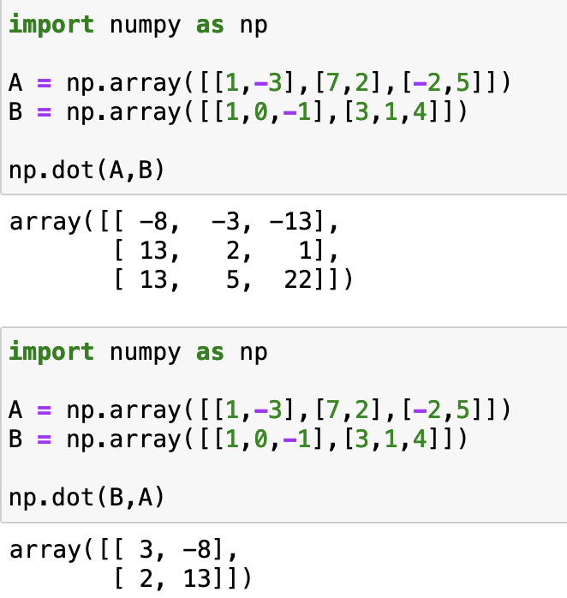
python

Slide 11
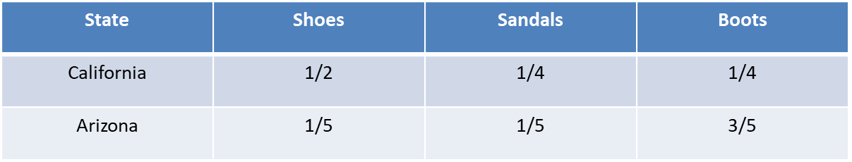
Matrix formulation
Sam’s Shoes and Frank’s Footwear both have outlets in California and Arizona. Sam’s sells shoes for $80, sandals for $40, and boots for $120. Frank’s prices are $60, $30, and $150, respectively. Half of all sales in California stores are shoes, 1/4 are sandals, and1/4 are boots. In Arizona, the fractions are 1/5 shoes, 1/5 sandals, and 3/5 boots.
🟦 Given Information:
We have:2 stores: Sam’s Shoes and Frank’s Footwear
2 states: California and Arizona
3 types of footwear: Shoes, Sandals, Boots
Sales Distribution of Footwear (as Fractions)
Prices:
Sam’s: Shoes = $80, Sandals = $40, Boots = $120
Frank’s: Shoes = $60, Sandals = $30, Boots = $150

Slide 12
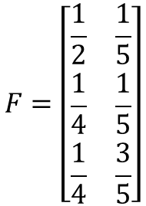

Matrix Formulation
✅ (a) Create a 2×3 matrix P for prices
Let’s order the items as:
Shoes, Sandals, Boots
Let rows represent:
Row 1 → Sam’s
Row 2 → Frank’s
So matrix P is:
✅ (b) Create a 3×2 matrix F for fractions of sales
Let rows represent:
Row 1 → Shoes
Row 2 → Sandals
Row 3 → Boots
Let columns represent:
Column 1 → California
Column 2 → Arizona
Shoes, Sandals, Boots
California
Arizona
P=$\left[\begin{matrix}80 & 40 & 120 \\ 60 & 30 & 150\end{matrix}\right]$
Sam
$$F=\left[\begin{matrix}\frac{1}{2} & \frac{1}{5} \\ \frac{1}{4} & \frac{1}{5} \\ \frac{1}{4} & \frac{3}{5}\end{matrix}\right]$$
Shoes
Sandals
Boots
Frank

Slide 13

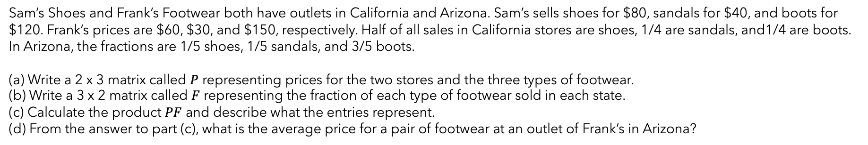

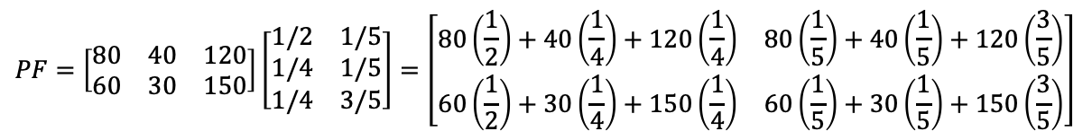
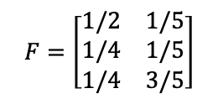
Sam’s Shoes and Frank’s Footwear both have outlets in California and Arizona. Sam’s sells shoes for $80, sandals for $40, and boots for $120. Frank’s prices are $60, $30, and $150, respectively. Half of all sales in California stores are shoes, 1/4 are sandals, and1/4 are boots. In Arizona, the fractions are 1/5 shoes, 1/5 sandals, and 3/5 boots.
(a) Write a 2 x 3 matrix called $P$ representing prices for the two stores and the three types of footwear.
(b) Write a 3 x 2 matrix called $F$ representing the fraction of each type of footwear sold in each state.
(c) Calculate the product $PF$ and describe what the entries represent.
(d) From the answer to part (c), what is the average price for a pair of footwear at an outlet of Frank’s in Arizona?
Sh Sa B
CA AR
$$P=\left[\begin{matrix}80 & 40 & 120 \\ 60 & 30 & 150\end{matrix}\right]$$
Sam’s
Frank’s
$$F=\left[\begin{matrix}1/2 & 1/5 \\ 1/4 & 1/5 \\ 1/4 & 3/5\end{matrix}\right]$$
Sh
Sa
B
$$PF=\left[\begin{matrix}80 & 40 & 120 \\ 60 & 30 & 150\end{matrix}\right]\left[\begin{matrix}1/2 & 1/5 \\ 1/4 & 1/5 \\ 1/4 & 3/5\end{matrix}\right]=\left[\begin{matrix}80\left(\frac{1}{2}\right)+40\left(\frac{1}{4}\right)+120\left(\frac{1}{4}\right) & 80\left(\frac{1}{5}\right)+40\left(\frac{1}{5}\right)+120\left(\frac{3}{5}\right) \\ 60\left(\frac{1}{2}\right)+30\left(\frac{1}{4}\right)+150\left(\frac{1}{4}\right) & 60\left(\frac{1}{5}\right)+30\left(\frac{1}{5}\right)+150\left(\frac{3}{5}\right)\end{matrix}\right]$$
CA AR
$$=\left[\begin{matrix}80 & 96 \\ 75 & 108\end{matrix}\right]$$
Sam’s
Frank’s
The rows give the average price per pair of footwear sold by each store and the columns give the state.
The entry in the 2nd row, 2nd column represents the average price of footwear at an outlet of Frank’s in Arizona: $108

Slide 14
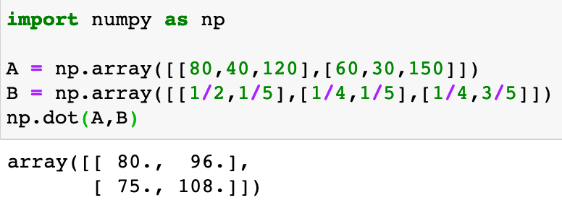
python

Slide 15
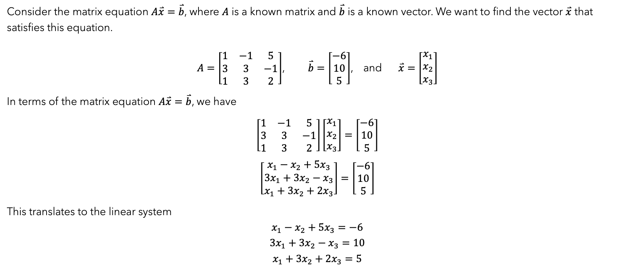
vector solutions
Consider the matrix equation $A\overset{⃑}{x}=\overset{⃑}{b}$, where $A$ is a known matrix and $\overset{⃑}{b}$ is a known vector. We want to find the vector $\overset{⃑}{x}$ that satisfies this equation.
$A=\left[\begin{matrix}1 & −1 & 5 \\ 3 & 3 & −1 \\ 1 & 3 & 2\end{matrix}\right]$, $\overset{⃑}{b}=\left[\begin{matrix}−6 \\ 10 \\ 5\end{matrix}\right]$, and $\overset{⃑}{x}=\left[\begin{matrix}x_{1} \\ x_{2} \\ x_{3}\end{matrix}\right]$
In terms of the matrix equation $A\overset{⃑}{x}=\overset{⃑}{b}$, we have
$$\left[\begin{matrix}1 & −1 & 5 \\ 3 & 3 & −1 \\ 1 & 3 & 2\end{matrix}\right]\left[\begin{matrix}x_{1} \\ x_{2} \\ x_{3}\end{matrix}\right]=\left[\begin{matrix}−6 \\ 10 \\ 5\end{matrix}\right]$$
$$\left[\begin{matrix}x_{1}−x_{2}+5x_{3} \\ 3x_{1}+3x_{2}−x_{3} \\ x_{1}+3x_{2}+2x_{3}\end{matrix}\right]=\left[\begin{matrix}−6 \\ 10 \\ 5\end{matrix}\right]$$
This translates to the linear system
$$x_{1}−x_{2}+5x_{3}=−6$$
$$3x_{1}+3x_{2}−x_{3}=10$$
$$x_{1}+3x_{2}+2x_{3}=5$$

Slide 16
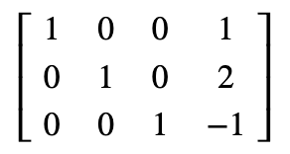

vector solutions continued
$$x_{1}−x_{2}+5x_{3}=−6$$
$$3x_{1}+3x_{2}−x_{3}=10$$
$$x_{1}+3x_{2}+2x_{3}=5$$
We can use the augmented matrix and perform row operations to find the row-reduced echelon form of this and get
This tells us $x_{1}=1$, $x_{2}=2$, and $x_{3}=−1$ which translates to
$$\overset{⃑}{x}=\left[\begin{matrix}1 \\ 2 \\ −1\end{matrix}\right]$$
As always, check the solution in the original system.

Slide 17
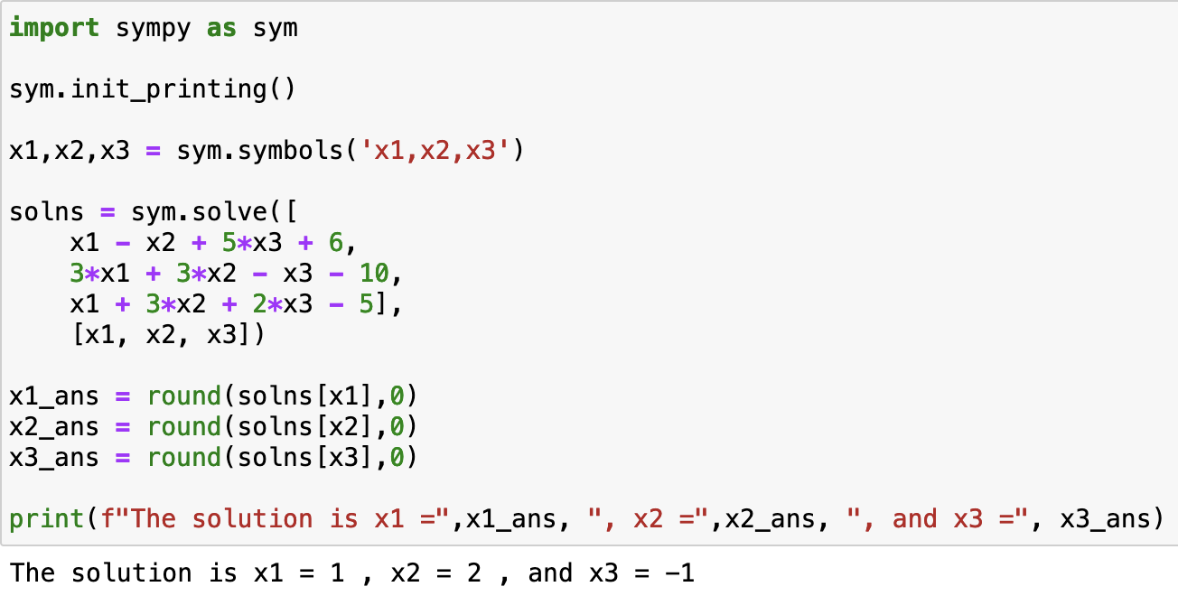
python

Slide 18
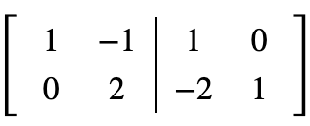
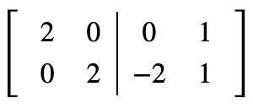
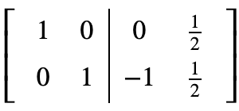
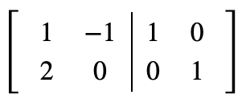




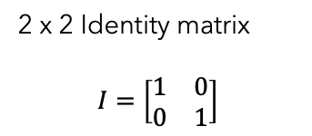


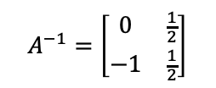

Multiplicative Inverses
2 x 2 Identity matrix
$$I=\left[\begin{matrix}1 & 0 \\ 0 & 1\end{matrix}\right]$$
Perform row operations to transform $A$ to $I$:
$${−2R}_{1}+R_{2}→R_{2}$$
If $A^{−1}$ exists, then $AA^{−1}=A^{−1}A=I$
Find $A^{−1}$ if $A=\left[\begin{matrix}1 & −1 \\ 2 & 0\end{matrix}\right]$
$$R_{2}+2R_{1}→R_{1}$$
Form the augmented matrix $[A|I]$:
$$\frac{1}{2}R_{1}→R_{1}$$
$$A^{−1}=\left[\begin{matrix}0 & \frac{1}{2} \\ −1 & \frac{1}{2}\end{matrix}\right]$$
$$\frac{1}{2}R_{2}→R_{2}$$
Your turn: Check $AA^{−1}=A^{−1}A=I$

Slide 19


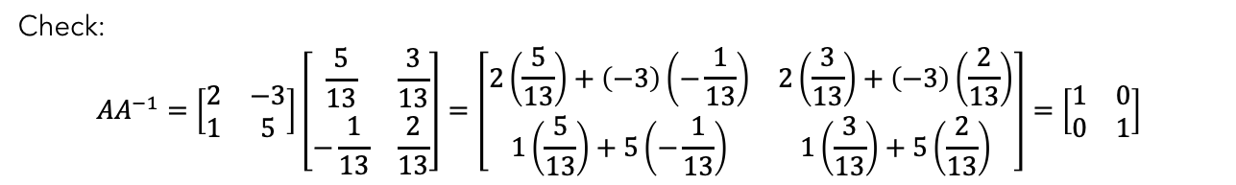
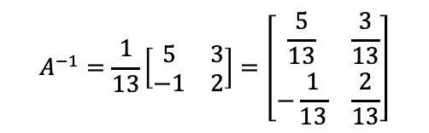

Alternative method with 2x2
If $A=\left[\begin{matrix}a & b \\ c & d\end{matrix}\right]$ and $ad−bc≠0$, then $A^{−1}=\frac{1}{ad−bc}\left[\begin{matrix}d & −b \\ −c & a\end{matrix}\right]$
Find $A^{−1}$ for $A=\left[\begin{matrix}2 & −3 \\ 1 & 5\end{matrix}\right]$, if it exists
$$2\left(5\right)−1\left(−3\right)=13$$
$$A^{−1}=\frac{1}{13}\left[\begin{matrix}5 & 3 \\ −1 & 2\end{matrix}\right]=\left[\begin{matrix}\frac{5}{13} & \frac{3}{13} \\ −\frac{1}{13} & \frac{2}{13}\end{matrix}\right]$$
Check:
$${AA}^{−1}=\left[\begin{matrix}2 & −3 \\ 1 & 5\end{matrix}\right]\left[\begin{matrix}\frac{5}{13} & \frac{3}{13} \\ −\frac{1}{13} & \frac{2}{13}\end{matrix}\right]=\left[\begin{matrix}2\left(\frac{5}{13}\right)+\left(−3\right)\left(−\frac{1}{13}\right) & 2\left(\frac{3}{13}\right)+\left(−3\right)\left(\frac{2}{13}\right) \\ 1\left(\frac{5}{13}\right)+5\left(−\frac{1}{13}\right) & 1\left(\frac{3}{13}\right)+5\left(\frac{2}{13}\right)\end{matrix}\right]=\left[\begin{matrix}1 & 0 \\ 0 & 1\end{matrix}\right]$$
Your turn: Verify $A^{−1}A=I$

Slide 20
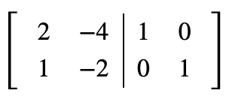
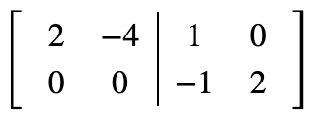



Inverse does not exist
Form the augmented matrix $[A|I]$
Find $A^{−1}$ for $A=\left[\begin{matrix}2 & −4 \\ 1 & −2\end{matrix}\right]$, if it exists
$$ad−bc=2\left(−2\right)−\left(−4\right)\left(1\right)=−4+4=0$$
Perform row operations to transform $A$ to $I$:
Inverse does not exist
$${−R}_{1}+2R_{2}→R_{2}$$
No way to complete the process. $A^{−1}$ does not exist.

Slide 21
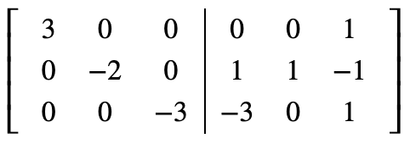
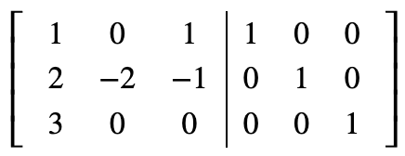
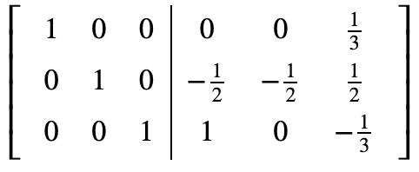
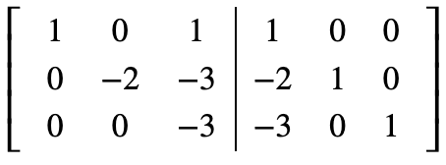





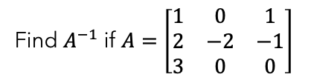
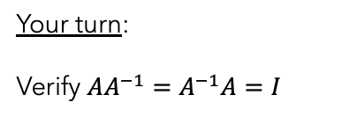

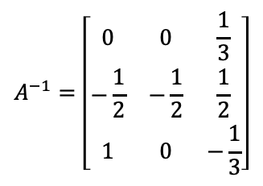


Example 3x3
Find $A^{−1}$ if $A=\left[\begin{matrix}1 & 0 & 1 \\ 2 & −2 & −1 \\ 3 & 0 & 0\end{matrix}\right]$
$$R_{3}+3R_{1}→R_{1}$$
$${−R}_{3}+R_{2}→R_{2}$$
Form the augmented matrix $[A|I]$:
$$\frac{1}{3}R_{1}→R_{1}$$
$$−\frac{1}{2}R_{2}→R_{2}$$
$$−\frac{1}{3}R_{3}→R_{3}$$
Your turn:
Verify $AA^{−1}=A^{−1}A=I$
$$−2R_{1}+R_{2}→R_{2}$$
$$A^{−1}=\left[\begin{matrix}0 & 0 & \frac{1}{3} \\ −\frac{1}{2} & −\frac{1}{2} & \frac{1}{2} \\ 1 & 0 & −\frac{1}{3}\end{matrix}\right]$$
$$−3R_{1}+R_{3}→R_{3}$$
Column 2 has zeros in required positions

Slide 22
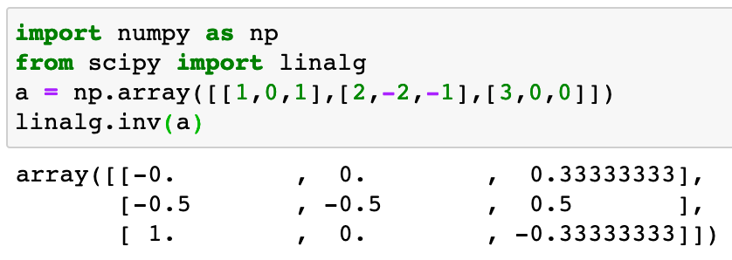
python

Slide 23
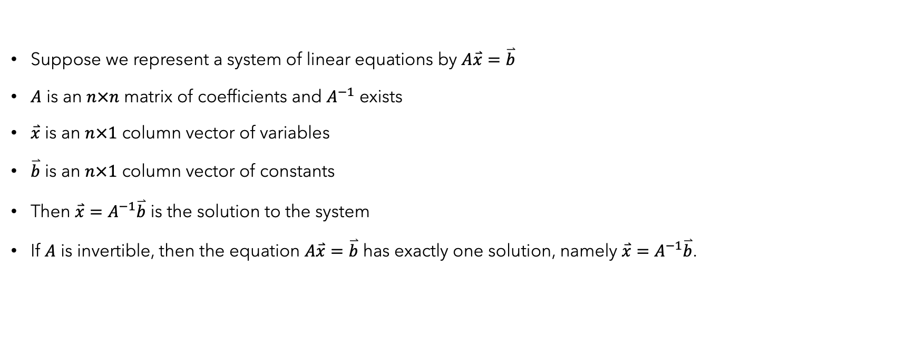
Using inverse to solve system
Suppose we represent a system of linear equations by $A\overset{⃑}{x}=\overset{⃑}{b}$
$A$ is an $n×n$ matrix of coefficients and $A^{−1}$ exists
$\overset{⃑}{x}$ is an $n×1$ column vector of variables
$\overset{⃑}{b}$ is an $n×1$ column vector of constants
Then $\overset{⃑}{x}=A^{−1}\overset{⃑}{b}$ is the solution to the system
If $A$ is invertible, then the equation $A\overset{⃑}{x}=\overset{⃑}{b}$ has exactly one solution, namely $\overset{⃑}{x}=A^{−1}\overset{⃑}{b}$.

Slide 24
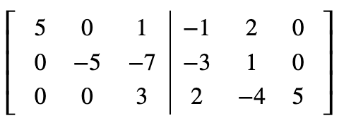
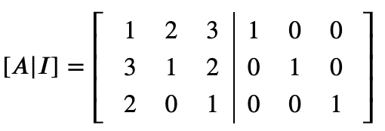
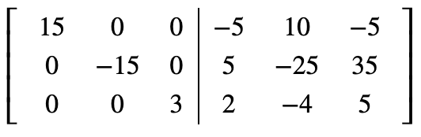
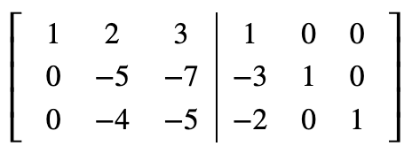
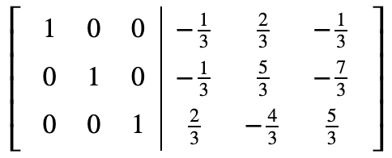




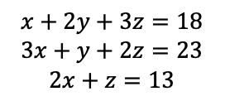

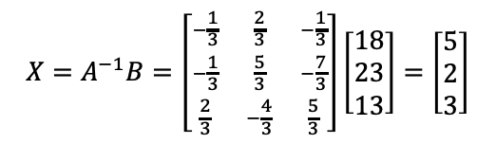



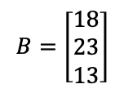
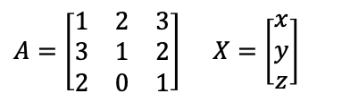

 |  | Brand
 |  | Veg Health | Grow Big | Nutriplant
Nutrient | Nitrogen | 1 | 2 | 3
 | Phosphoric Acid | 3 | 1 | 2
 | Potash | 2 | 0 | 1
Three brands of fertilizer are available to provide nitrogen, phosphoric acid, and potash. One bag of each brand provides the units of each nutrient shown in the table.
For ideal growth, the soil on a Michigan farm needs 18 units of nitrogen, 23 units of phosphoric acid, and 13 units of potash per acre. How many bags of each brand of fertilizer should be used per acre for ideal growth on the farm?
Let $x$ = bags fertilizer from Veg Health, $y$ = bags of fertilizer from Grow Big, and $z$ = bags of fertilizer from Nutriplant
$$x+2y+3z=18$$
$$3x+y+2z=23$$
$$2x+z=13$$
$A=\left[\begin{matrix}1 & 2 & 3 \\ 3 & 1 & 2 \\ 2 & 0 & 1\end{matrix}\right]$ $X=\left[\begin{matrix}x \\ y \\ z\end{matrix}\right]$
$$B=\left[\begin{matrix}18 \\ 23 \\ 13\end{matrix}\right]$$
$$2R_{2}+5R_{1}→R_{1}$$
$$−4R_{2}+{5R}_{3}→R_{3}$$
$$X=A^{−1}B=\left[\begin{matrix}−\frac{1}{3} & \frac{2}{3} & −\frac{1}{3} \\ −\frac{1}{3} & \frac{5}{3} & −\frac{7}{3} \\ \frac{2}{3} & −\frac{4}{3} & \frac{5}{3}\end{matrix}\right]\left[\begin{matrix}18 \\ 23 \\ 13\end{matrix}\right]=\left[\begin{matrix}5 \\ 2 \\ 3\end{matrix}\right]$$
$$−R_{3}+{3R}_{1}→R_{1}$$
$$7R_{3}+3R_{2}→R_{2}$$
$$\frac{1}{15}R_{1}→R_{1}$$
$$−3R_{1}+R_{2}→R_{2}$$
$$−\frac{1}{15}R_{2}→R_{2}$$
$$−2R_{1}+R_{3}→R_{3}$$
$$\frac{1}{3}R_{3}→R_{3}$$
Use 5 bags of Veg Health, 2 bags of Grow Big, and 3 bags of Nutriplant

Slide 25
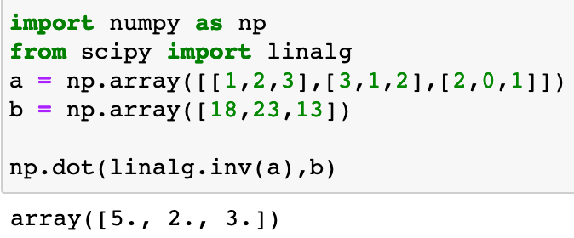
python

Slide 26
Questions?

Slide 27
Module 2
operations on matrices

Slide 28

matrix transposE
The transpose of a matrix switches rows and columns, i.e. an $m×n$ matrix becomes an $n×m$ matrix.
$A=\left[\begin{matrix}2 & −1 & 7 \\ −3 & 0 & −4\end{matrix}\right]$ becomes $A^{T}=\left[\begin{matrix}2 & −3 \\ −1 & 0 \\ 7 & −4\end{matrix}\right]$
Properties:
Let $A$ and $B$ be matrices where the following operations are defined. Then:
${\left(A+B\right)}^{T}=A^{T}+B^{T}$ and ${\left(A−B\right)}^{T}=A^{T}−B^{T}$
${\left(kA\right)}^{T}=kA^{T}$
${\left(AB\right)}^{T}=B^{T}A^{T}$
${\left(A^{−1}\right)}^{T}={\left(A^{T}\right)}^{−1}$
${\left(A^{T}\right)}^{T}=A$

Slide 29
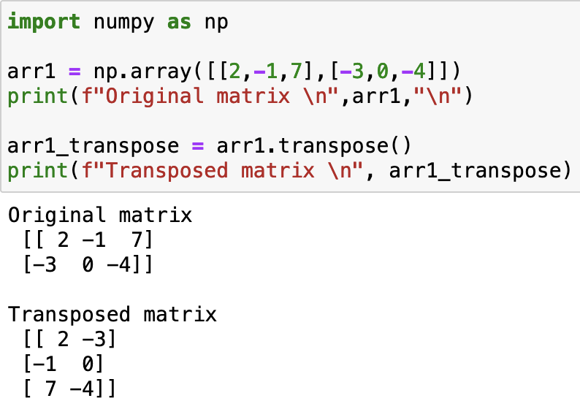
python

Slide 30

matrix trace
The trace of an $n×n$ matrix is the sum of the elements along the diagonal. This only works with square matrices.
$A=\left[\begin{matrix}6 & 0 & −4 \\ 1 & 2 & 5 \\ 10 & −1 & 3\end{matrix}\right]$ and $tr\left(A\right)=6+2+3=11$
Properties:
Let $A$ and $B$ be $n×n$ matrices. Then:
$tr\left(A+B\right)=tr\left(A\right)+tr(B)$ and $tr\left(A−B\right)=tr\left(A\right)−tr(B)$
$tr\left(kA\right)=k∙tr(A)$
$tr\left(AB\right)=tr(BA)$
$tr\left(A^{T}\right)=tr(A)$

Slide 31

python

Slide 32



Determinant: 2x2
Determinant of $A=\left[\begin{matrix}a_{11} & a_{12} \\ a_{21} & a_{22}\end{matrix}\right]$:
$$det(A)=\left|A\right|=a_{11}a_{22}−a_{12}a_{21}$$
Calculate the determinant of $A=\left[\begin{matrix}−5 & 3 \\ 7 & −1\end{matrix}\right]$
$$\left|A\right|=\left(−5\right)\left(−1\right)−\left(3\right)\left(7\right)=5−21=−16$$
Note: This is a square matrix with determinant ≠ 0, so the inverse exists
Your turn: Find $A^{−1}$. Use $A^{−1}=\frac{1}{|A|}\left[\begin{matrix}a_{22} & −a_{12} \\ −a_{21} & a_{11}\end{matrix}\right]$
Notes:
Det: {square matrices} -> R such that
1) Doing a row replacement on A does not change det(A).\
2) Scaling a row of A by a scalar c multiplies the determinant by c.
3) Swapping two rows of a matrix multiplies the determinant by −1.
4) The determinant of the identity matrix In is equal to 1.
Area of figure defined by v1 = [a11, a12], v2 = [a21,a22] is det(A)

Slide 33










Determinant: 3x3
Determinant of $A=\left[\begin{matrix}a_{11} & a_{12} & a_{13} \\ a_{21} & a_{22} & a_{23} \\ a_{31} & a_{32} & a_{33}\end{matrix}\right]$:
$$\det\left(A\right)=\left|A\right|=a_{11}a_{22}a_{33}+a_{12}a_{23}a_{31}+a_{13}a_{21}a_{32}−a_{13}a_{22}a_{31}−a_{11}a_{23}a_{32}−a_{12}a_{21}a_{33}$$
Find $|A|$ for $A=\left[\begin{matrix}1 & 3 & −2 \\ 2 & 7 & −3 \\ 3 & 8 & −5\end{matrix}\right]$
Augment $A$ with the first two columns of $A$
$$\left|A\right|=$$
$$(1)(7)(−5)$$
$$+(3)(−3)(3)$$
$$+(−2)(2)(8)$$
$$−(−2)(7)(3)$$
$$−(1)(−3)(8)$$
$$−(3)(2)(−5)$$
$$=−35−27−32+42+24+30=2$$

Slide 34

python

Slide 35





matrix minor and cofactor
Let $A$ be an $n×n$ matrix. The $i,j$ minor of $A$, denoted $A_{i,j}$, is the determinant of the $\left(n−1\right)×\left(n−1\right)$ matrix formed by deleting the $i^{th}$ row and the $j^{th}$ column of $A$.
The $i,j$ cofactor of $A$ is given by
$$C_{i,j}={\left(−1\right)}^{i+j}A_{i,j}$$
Find the $2,3$ cofactor of $A$:

Slide 36

cofactor expansion
The cofactor expansion is an alternative way to calculate the determinant of an $n×n$ matrix.
Let $A$ be an $n×n$ matrix.
The cofactor expansion of $A$ along the $i^{th}$ row is given by
$$\det\left(A\right)=a_{i,1}C_{i,1}+a_{i,2}C_{i,2}+…+a_{i,n}C_{i,n}$$
The cofactor expansion of $A$ along the $j^{th}$ column is given by
$$\det\left(A\right)=a_{1,j}C_{1,j}+a_{2,j}C_{2,j}+…+a_{n,j}C_{n,j}$$

Slide 37


cofactor expansion
Using the cofactor expansion along the 2nd row, find the determinant of the following matrix:
$$\det\left(A\right)=−3C_{2,1}+\left(−5\right)C_{2,2}+2C_{2,3}+5C_{2,4}$$
$$=−3{\left(−1\right)}^{2+1}A_{2,1}+\left(−5\right){\left(−1\right)}^{2+2}A_{2,2}+2{\left(−1\right)}^{2+3}A_{2,3}+5{\left(−1\right)}^{2+4}A_{2,4}$$
$$=3A_{2,1}−5A_{2,2}−2A_{2,3}+5A_{2,4}$$
$$=3\left(3\right)−3\left(−15\right)−2\left(46\right)+5\left(−21\right)=−113$$

Slide 38



python

Slide 39










Cramer’s rule: 2x2
Consider the system of equations:
$$a_{1}x+b_{1}y=c_{1}$$
$$a_{2}x+b_{2}y=c_{2}$$
Define
$D_{x}=\left|\begin{matrix}c_{1} & b_{1} \\ c_{2} & b_{2}\end{matrix}\right|$ and $D_{y}=\left|\begin{matrix}a_{1} & c_{1} \\ a_{2} & c_{2}\end{matrix}\right|$
The solution to the system is given by
$$x=\frac{D_{x}}{D}, y=\frac{D_{y}}{D}$$
Let $D$ be the determinant of the coefficient matrix and assume $D≠0$
$$2x+5y=15$$
$$x+4y=9$$
$$D=\left|\begin{matrix}2 & 5 \\ 1 & 4\end{matrix}\right|=\left(2\right)\left(4\right)−\left(5\right)\left(1\right)=3$$
$$D_{x}=\left|\begin{matrix}15 & 5 \\ 9 & 4\end{matrix}\right|=\left(15\right)\left(4\right)−\left(5\right)\left(9\right)=15$$
$$D_{y}=\left|\begin{matrix}2 & 15 \\ 1 & 9\end{matrix}\right|=\left(2\right)\left(9\right)−\left(15\right)\left(1\right)=3$$
$$x=\frac{D_{x}}{D}=\frac{15}{3}=5$$
$$y=\frac{D_{y}}{D}=\frac{3}{3}=1$$
Your turn: Check the solution

Slide 40



Cramer’s rule: 3x3
Consider the system of linear equations
$$a_{1}x+b_{1}y+c_{1}z=d_{1}$$
$$a_{2}x+b_{2}y+c_{2}z=d_{2}$$
$$a_{3}x+b_{3}y+c_{3}z=d_{3}$$
Let $D$ be the determinant of the coefficient matrix and assume $D≠0$
Define
$D_{x}=\left|\begin{matrix}d_{1} & b_{1} & c_{1} \\ d_{2} & b_{2} & c_{2} \\ d_{3} & b_{3} & c_{3}\end{matrix}\right|$, $D_{y}=\left|\begin{matrix}a_{1} & d_{1} & c_{1} \\ a_{2} & d_{2} & c_{2} \\ a_{3} & d_{3} & c_{3}\end{matrix}\right|$ and $D_{z}=\left|\begin{matrix}a_{1} & b_{1} & d_{1} \\ a_{2} & b_{2} & d_{2} \\ a_{3} & b_{3} & d_{3}\end{matrix}\right|$
The solution to the system is given by
$$x=\frac{D_{x}}{D}, y=\frac{D_{y}}{D}, z=\frac{D_{z}}{D}$$

Slide 41









example
Recall the fertilizer example
$$x+2y+3z=18$$
$$3x+y+2z=23$$
$$2x+z=13$$
$$D_{x}=\left|\begin{matrix}18 & 2 & 3 \\ 23 & 1 & 2 \\ 13 & 0 & 1\end{matrix}\right|=−15$$
$$x=\frac{−15}{−3}=5$$
The solution is $\left(5, 2, 3\right)$
$$D=\left|\begin{matrix}1 & 2 & 3 \\ 3 & 1 & 2 \\ 2 & 0 & 1\end{matrix}\right|=−3$$
$$D_{y}=\left|\begin{matrix}1 & 18 & 3 \\ 3 & 23 & 2 \\ 2 & 13 & 1\end{matrix}\right|=−6$$
$$y=\frac{−6}{−3}=2$$
$$D_{z}=\left|\begin{matrix}1 & 2 & 18 \\ 3 & 1 & 23 \\ 2 & 0 & 13\end{matrix}\right|=−9$$
$$z=\frac{−9}{−3}=3$$

Slide 42

python

Slide 43
Questions?

Slide 44
Module 2
eigenvalues & eigenvectors

Slide 45

Motivation
Consider multiplying nonzero vectors by a given square matrix, such as
$\left[\begin{matrix}6 & 3 \\ 4 & 7\end{matrix}\right]\left[\begin{matrix}5 \\ 1\end{matrix}\right]=\left[\begin{matrix}33 \\ 27\end{matrix}\right]$ or $\left[\begin{matrix}6 & 3 \\ 4 & 7\end{matrix}\right]\left[\begin{matrix}3 \\ 4\end{matrix}\right]=\left[\begin{matrix}30 \\ 40\end{matrix}\right]$
In the 1st case we have a new vector with a different direction and a different length, which is uninteresting.
In the 2nd case the multiplication produces a multiple of the original vector. This means the new vector has the same direction as the original vector.
$$\left[\begin{matrix}30 \\ 40\end{matrix}\right]=10\left[\begin{matrix}3 \\ 4\end{matrix}\right]$$
In this example we say $λ=10$ is an eigenvalue and the vector $\overset{⃑}{x}={\left[\begin{matrix}3 & 4\end{matrix}\right]}^{T}$ is an eigenvector.
Eigenvalues represent the scaling factor by which a vector is transformed when a linear transformation is applied.
Some applications in machine learning include feature extraction, dimensionality reduction, and clustering.

Slide 46

eigenvalues and eigenvectors
Let $A$ be an $n×n$ matrix, $\overset{⃑}{x}$ a nonzero $n×1$ column vector and $λ$ a scalar. If
$$A\overset{⃑}{x}=λ\overset{⃑}{x},$$
then $\overset{⃑}{x}$ is an eigenvector of $A$ and $λ$ is an eigenvalue of $A$.
Let’s take a closer look and try to solve the equation for $\overset{⃑}{x}$:
$$A\overset{⃑}{x}=λ\overset{⃑}{x}$$
$$A\overset{⃑}{x}−λ\overset{⃑}{x}=\overset{⃑}{0}$$
$$\left(A−λI\right)\overset{⃑}{x}=\overset{⃑}{0}$$
Recall: If $A−λI$ is invertible, then there is exactly one solution, namely $\overset{⃑}{x}=\overset{⃑}{0}$.
Thus, to have nonzero solutions we need $A−λI$ to not be invertible.
Taking this further, noninvertible matrices all have a determinant of $0$.
So, if we want to find eigenvalues and eigenvectors we need $\det\left(A−λI\right)=0$.

Slide 47

example
$$A=\left[\begin{matrix}3 & 12 \\ 1 & −1\end{matrix}\right]$$
Find the eigenvalues and eigenvectors of $A$.
$$A−λI=\left[\begin{matrix}3 & 12 \\ 1 & −1\end{matrix}\right]−λ\left[\begin{matrix}1 & 0 \\ 0 & 1\end{matrix}\right]$$
$$=\left[\begin{matrix}3 & 12 \\ 1 & −1\end{matrix}\right]−\left[\begin{matrix}λ & 0 \\ 0 & λ\end{matrix}\right]$$
$$=\left[\begin{matrix}3−λ & 12 \\ 1 & −1−λ\end{matrix}\right]$$
So
$$\det\left(A−λI\right)=\left|\begin{matrix}3−λ & 12 \\ 1 & −1−λ\end{matrix}\right|$$
$$\left(3−λ\right)\left(−1−λ\right)−12$$
$$λ^{2}−2λ−15$$
We want $\det\left(A−λI\right)=0$, or $λ^{2}−2λ−15=0$.
$$λ^{2}−2λ−15=0$$
$$\left(λ+3\right)\left(λ−5\right)=0$$
So the eigenvalues are $λ=−3$ and $λ=5$.

Slide 48


example continued
For $λ=−3$ we need to solve $\left(A−\left(−3\right)I\right)\overset{⃑}{x}=\overset{⃑}{0}$.
$$\left[\begin{matrix}3+3 & 12 \\ 1 & −1+3\end{matrix}\right]\left[\begin{matrix}x_{1} \\ x_{2}\end{matrix}\right]=\left[\begin{matrix}0 \\ 0\end{matrix}\right]$$
$$\left[\begin{matrix}6 & 12 \\ 1 & 2\end{matrix}\right]\left[\begin{matrix}x_{1} \\ x_{2}\end{matrix}\right]=\left[\begin{matrix}0 \\ 0\end{matrix}\right]$$
If we put this in row-reduced echelon form we have
$$\left[\begin{matrix}1 & 2 \\ 0 & 0\end{matrix}\right]\left[\begin{matrix}x_{1} \\ x_{2}\end{matrix}\right]=\left[\begin{matrix}0 \\ 0\end{matrix}\right]$$
So $x_{1}=−2x_{2}$ and $x_{2}$ is free.
$$\overset{⃑}{x}=x_{2}\left[\begin{matrix}−2 \\ 1\end{matrix}\right]$$
We can pick any nonzero value for $x_{2}$ so let $x_{2}=1$.
$$\overset{⃑}{x}=\left[\begin{matrix}−2 \\ 1\end{matrix}\right]$$
Alternatively, we can convert this to a linear system:
$$6x_{1}+12x_{2}=0$$
$$x_{1}+2x_{2}=0$$
Or equivalently:
$$x_{1}+2x_{2}=0$$
$$x_{1}+2x_{2}=0$$
Then:
$$x_{1}+2x_{2}=0$$
$$0=0$$

Slide 49


example continued
For $λ=5$ we need to solve $\left(A−5I\right)\overset{⃑}{x}=\overset{⃑}{0}$.
$$\left[\begin{matrix}3−5 & 12 \\ 1 & −1−5\end{matrix}\right]\left[\begin{matrix}x_{1} \\ x_{2}\end{matrix}\right]=\left[\begin{matrix}0 \\ 0\end{matrix}\right]$$
$$\left[\begin{matrix}−2 & 12 \\ 1 & −6\end{matrix}\right]\left[\begin{matrix}x_{1} \\ x_{2}\end{matrix}\right]=\left[\begin{matrix}0 \\ 0\end{matrix}\right]$$
If we put this in row-reduced echelon form we have
$$\left[\begin{matrix}1 & −6 \\ 0 & 0\end{matrix}\right]\left[\begin{matrix}x_{1} \\ x_{2}\end{matrix}\right]=\left[\begin{matrix}0 \\ 0\end{matrix}\right]$$
So $x_{1}=6x_{2}$ and $x_{2}$ is free.
$$\overset{⃑}{x}=x_{2}\left[\begin{matrix}6 \\ 1\end{matrix}\right]$$
We can pick any nonzero value for $x_{2}$ so let $x_{2}=1$.
$$\overset{⃑}{x}=\left[\begin{matrix}6 \\ 1\end{matrix}\right]$$
Converting this to a linear system:
$${−2x}_{1}+12x_{2}=0$$
$$x_{1}−6x_{2}=0$$
Or equivalently:
$$x_{1}−6x_{2}=0$$
$$x_{1}−6x_{2}=0$$
Then:
$$x_{1}+2x_{2}=0$$
$$0=0$$

Slide 50

python

Slide 51

properties of eigenvalues and eigenvectors
Let $A$ be an $n×n$ invertible matrix. Then the following are true:
If $A$ is triangular, then the diagonal elements of $A$ are the eigenvalues of $A$.
If $λ$ is an eigenvalue of $A$ with eigenvector $\overset{⃑}{x}$, then $1/λ$ is an eigenvalue of $A^{−1}$ with eigenvector $\overset{⃑}{x}$.
If $λ$ is an eigenvalue of $A$, then $λ$ is an eigenvalue of $A^{T}$.
The sum of the eigenvalues of $A$ is equal to $tr\left(A\right)$.
The product of the eigenvalues is equal to the determinant of $det \left(A\right)$.

Slide 52
Questions?

